Slide 1
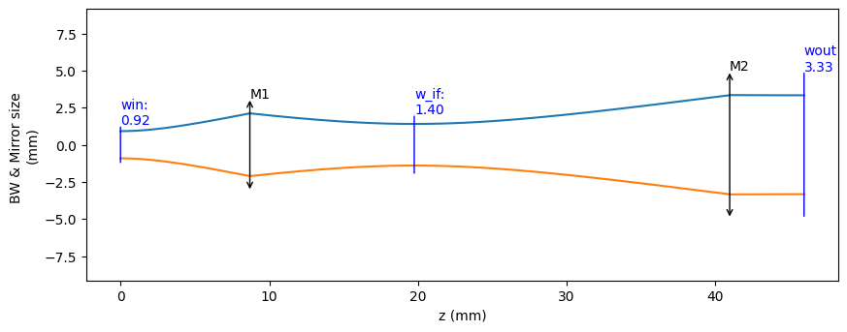
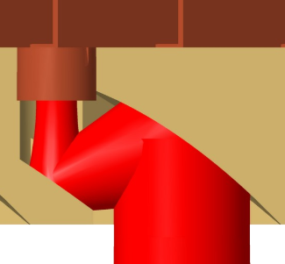
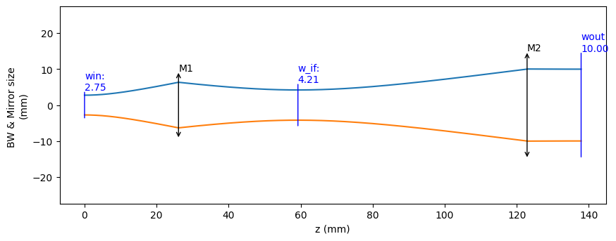
Phase Center Measurement for the ‘Gibson’ Horn
@475GHz
Horn
8.696
11.052
21.21
5
M2
M1
Optics model of the Fore-optics .
26.0865
33.155
63.618
15

